Slide 1
Capstone Project Where could I open my next business place in London?
Andi Breshanaj

Slide 2
Introduction to the problem
In this project I want to analyze a dataset of London City to find where a person could open a place for his/her business
In particular with the Foursquare location data I will try to figure out the main problem: which is the best place to open a business?
The people that could be interested are everybody: someone that have enough money to open a business or maybe a graduated student from university that want to start a new challenge

Slide 3
Dataset
The information that I'm going to use for the Capstone project are located in this site.
Basically the dataset is quite huge (about 135 MB and 320426 rows with 44 attribute), so for this reason I will use basic info such as:
District
District Code
Ward (Neighborhood)
Before to start the analyze I decided to filter some of the rows with the "In Use?" attribute that defines if a postcode is it used or not.
After this filtering I'm going to use an Unsupervised Algorithm: K-Means.
Unfortunately the latitude and the longitude of the dataframe are for every postcode so I'm going to use some external services to find the lat and lon of each district code. At the end for each district I will try to find with the Foursquare data the best place to open a business for each district.

Slide 4
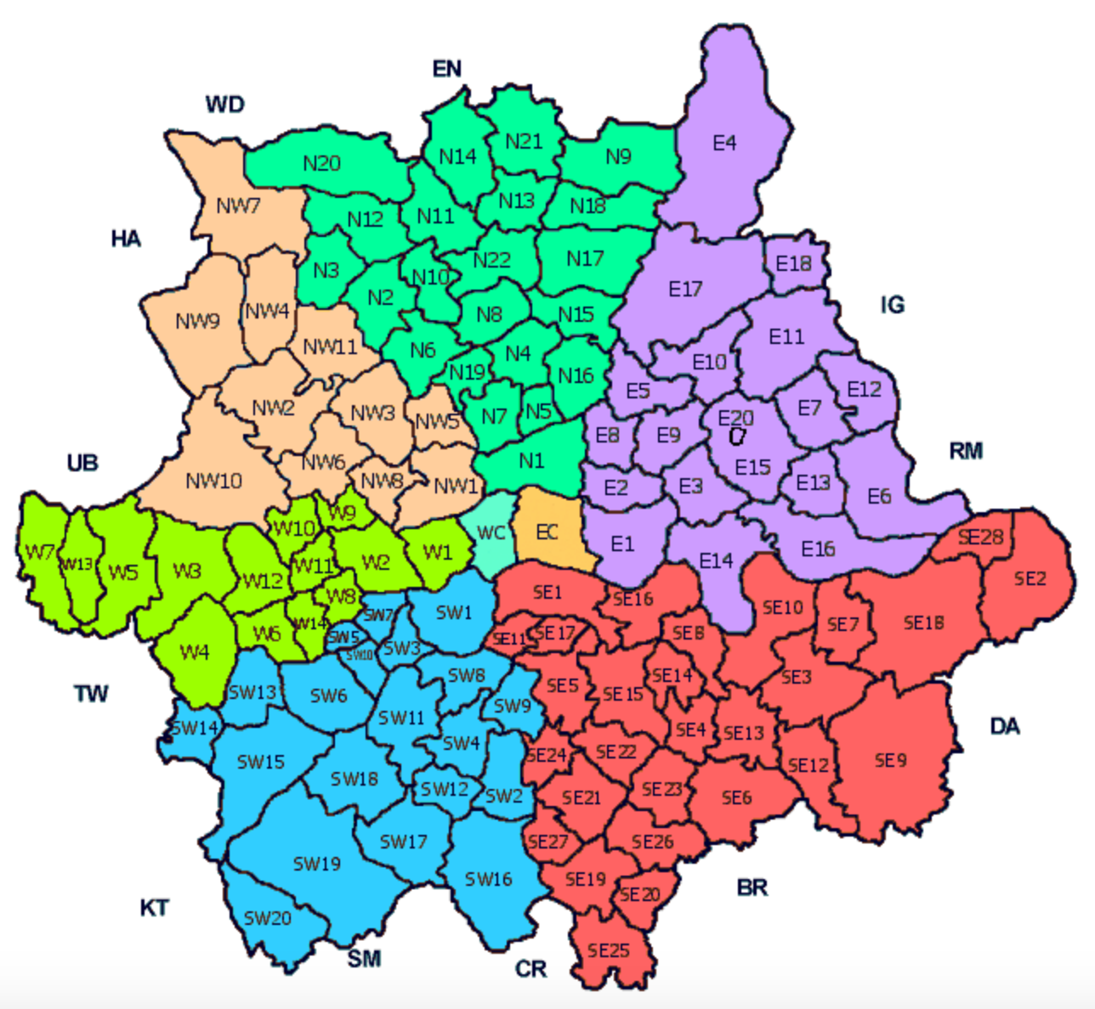
Dataset List of London postcode districts
https://www.doogal.co.uk/london_postcodes.php

Slide 5
Info about the Dataset
44 attributes
320426 rows (177967 after the filtering)
33 District used
691 Neibourhoods

Slide 6
Methodology
For this project I used an unsupervised algorithm: Kmeans with k = 4
In the next slide there is a picture there is a map of district of the city of London
There are 207 uniques categories.
ISSUE: I didn’t find any resource in the Internet to find latitude and longitude of the District. For this reason I used a service at this site https://www.latlong.net/

Slide 7
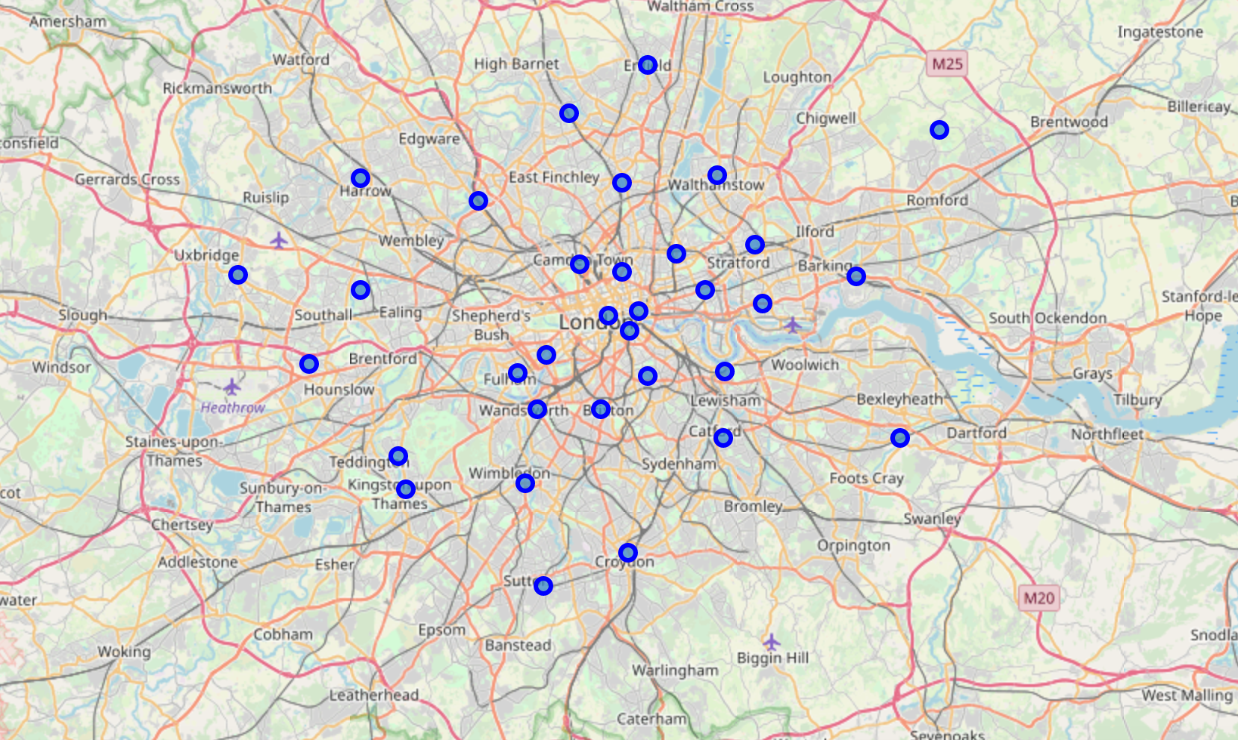
Map of London with 33 districts

Slide 8
Results
This are the main results:
Coffee shop is the best place to open a business in London
The best places as the above slide will explain better are situated in the city centre

Slide 9
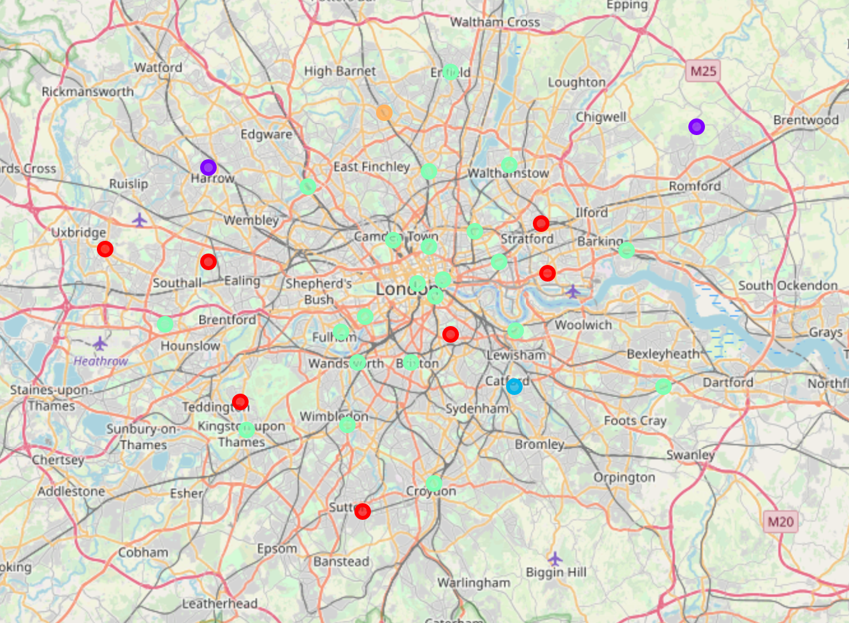
Cluster neighbourhoods

Slide 10
Discussions
The study of the places and the most venues in London was an exciting project. I found some issues especially:
Where to find a good daset with consistent info about the city of London
Find the Latitudes and longitudes of the districts

Slide 11
Conclusions
The analysis suggest that the best business to open in London are:
'Coffee Shop’: 22%,
'Café’: 16%,
'Pub’: 16%
The best place to open one of the 3 business above is in the city centre.

